Slide 1




Welcome to our Parent Consultation
Relationships, Sex & Health Education
Notes:
Welcome- thank you for joining us
Parent Partnership
Intros

Slide 2
Today we aim to inform you of…
The school’s legal obligations on Relationships, Sex & Health Education and why we teach it.
What we mean by sex education
How, what, why and when we intend to teach children
Your rights as a parent/carer
Ways you can support your child at home

Slide 3

A quick question…
Where and when did you learn about relationships, puberty and human reproduction?
Was it the best way?
Who told you?
Were you confused about anything?
Has the world changed since then?

Slide 4



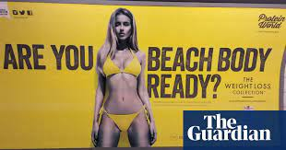
Friends
Family
School
The internet
Television
Social Media
Other media

Slide 5
Government Guidance tells us…
‘We want all children to grow up healthy, happy, safe, and able to manage the challenges and opportunities of modern Britain. That is why, from September 2020, all primary age children will be taught Relationships and Health Education.’
LGBT+ Equality
‘Schools are required to comply with relevant requirements of The Equality Act 2010’ Para 27 pg 13
‘Schools should be alive to issues such as everyday sexism, misogyny, homophobia and gender stereotypes and take positive action to build a culture where these are not tolerated’ para 31 pg 13
Notes:
From sept 2020 schools have to teach about relationships and health
They were already doing this but it wasn’t a legal requirement.
They have to make sure that its covered in an age appropriate way across the school .
That all pupils get the learning they need for their age and ability , so includes all pupils.
They have to get parents views about the curriculum and
make sure that they meet the needs of the pupils in their school.
They have to make sure they comply with equality Act , so they must reflect the society we live in and help children to understand and respect difference.

Slide 6

Government Guidance tells us…
Parents should be given the opportunity to understand the purpose and content of Relationships Education.
Parents have the right to request that their child be withdrawn from some of sex education.
Notes:
The government guidance recognises that parents are the prime educators for their children on these aspects.
So they learn first form the home and secondly from school. Pupils learn best when they get consistent message form home and school so this session is about starting that journey really to work together more on this area.
Also recognise that some parents prefer to educate their children about some sensitive issues such as sex education and so that have retained the right for parent o withdraw their child form the parts of the curriculum that are sex education . There isn’t a right to withdraw form Relationship education or Health Education , just the bits of sex education that are not included in those areas.
We will again go into more detail later on.

Slide 7

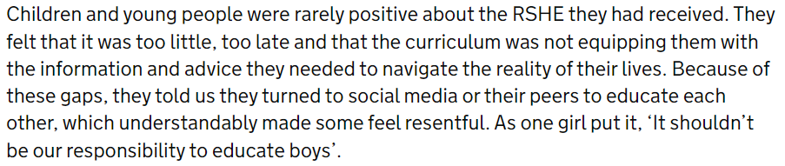
https://www.gov.uk/government/publications/review-of-sexual-abuse-in-schools-and-colleges/review-of-sexual-abuse-in-schools-and-colleges#is-the-existing-safeguarding-framework-and-guidance-for-inspectors-strong-enough-to-properly-assess-how-schools-and-colleges-safeguard-and-promote-the-welfare-of-children

Slide 8
Real stories from across the UK…
A 6 year old child explained someone had ‘hurt her biscuit’. This was missed by staff as she hadn’t used the correct terminology.
Two 10 year olds being groomed online- they thought the people were nice and sent images of them in make-up and in underwear- they said they felt ‘grown up’
A 9 year old accessing porn through clickbait
Notes:
Just a selection of stories- things like this are happening all the time across our country and with our children- it isn’t just teens as we are led to believe.

Slide 9
Our Shared Goal
We want children to be happy, healthy and have the skills and knowledge to live in the real world safely
When it comes to puberty, relationships and human reproduction, we don’t want children to believe myths and half truths.
We want them to be aware of the facts and we want them to build healthy attitudes and positive relationships with others
Notes:
We want to work in partnership with you to…

Slide 10
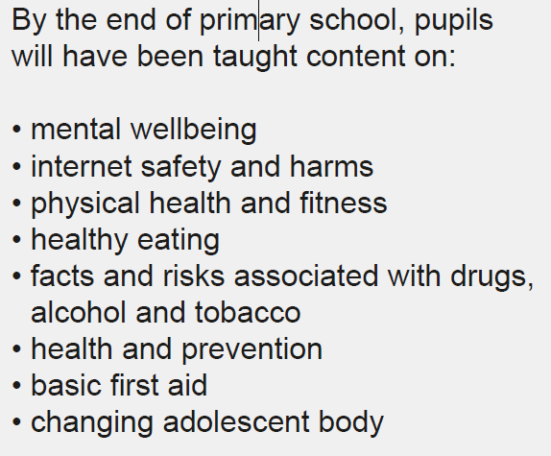
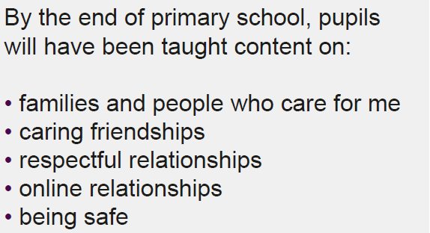
So what do we teach…
Notes:
We have covered why we teach it- survey, government guidance and why we as a school believe it is important now let’s talk about what we teach.
This is the key content as made statutory by the government. We teach through Jigsaw but adapt to suit the needs of our children and community.

Slide 11
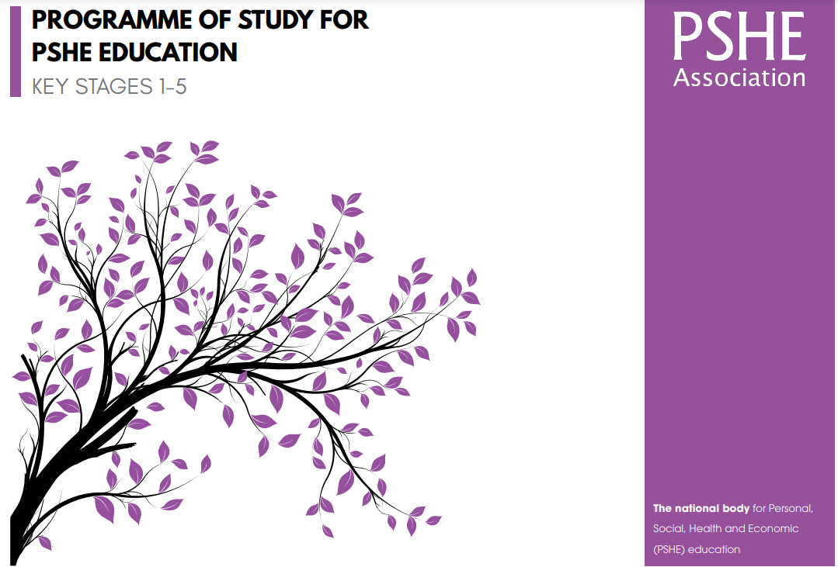
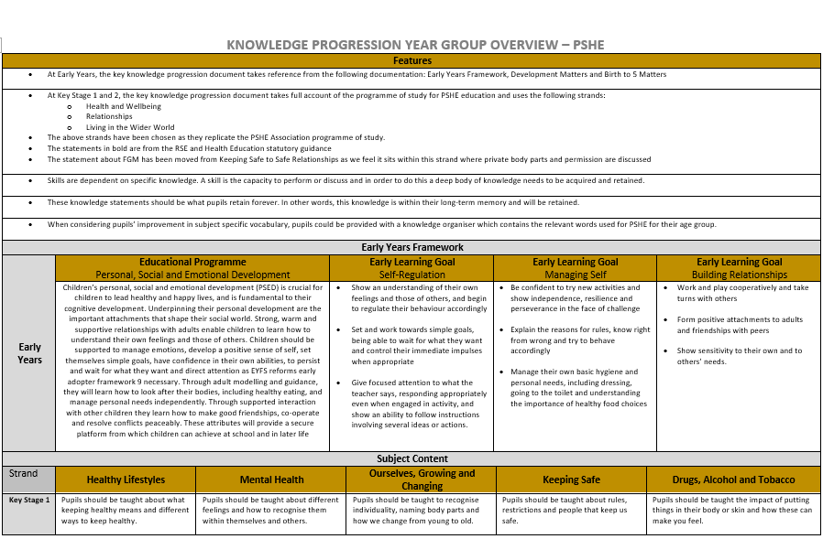
How do we ensure the quality of our PSHE curriculum?
Notes:
The Government recommend the programme of study for PSHE education, which explains what children should have learnt by the end of Ks1 and Ks2.
We then use the Flying High Trust KKPD document, which breaks these statements into little steps for each year group, ensuring that learning is age appropriate, and progression across year groups.
Then as a school, we use the Jigsaw scheme to resource of lessons, to ensure teachers are confident in what they are delivering and that all of our resources are age appropriate.

Slide 12

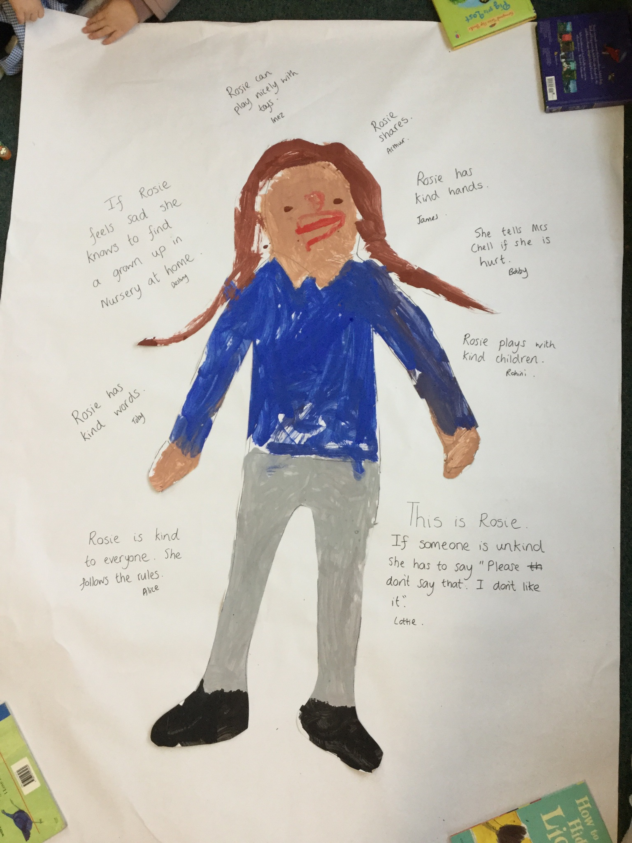
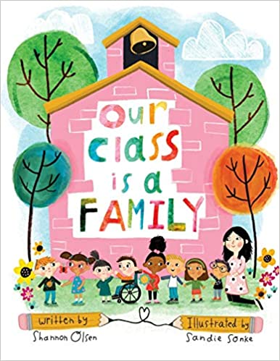

Positive Relationships
Values
Interacting appropriately- conflict
Different kinds of relationships and families
What is a good relationship and friendship? Discuss range of relationships
What a positive, safe, healthy, caring relationship looks like
How to speak up and get help when a relationship does not feel safe
How to make and maintain healthy relationships (online and offline)
Notes:
Four key areas to RSE: Relationships, Safety, Health Education, Age appropriate Sex Education. I will outline the kinds of things we will teach in each one.
Values: Respect, care, kindness, positivity, empathy, ‘love is love’.
Interactions: Being solution focussed, respectful of other opinions and ideas etc., sharing
Different kinds of relationships and families to promote equality and so our teaching and learning reflects society
What is a good relationship? e.g. a friendship, a family relationship, a work based relationship, marriage/civil partnership.

Slide 13
Sex Education
The government recommends...
that all primary schools ‘have a sex education programme tailored to the age and the physical and emotional maturity of the pupils’
Sex education ‘should ensure that both boys and girls are prepared for the changes that adolescence brings and – drawing on knowledge of the human life cycle set out in the national curriculum for science - how a baby is conceived and born’.
We define sex education as about ‘human reproduction’ and not about sexual activity.
KS2 Sex education links to the National Curriculum for Science
‘describe the life process of reproduction in some plants and animals’
‘learn about the changes experienced in puberty’
Notes:
Government guidance recommends (read)
It will be age appropriate always and sensitive to the class group and individuals- it isn’t a one size fits all approach.
This aspect of our RSE programme is small and relates to the teaching which is statutory. It is scientific and gives children the correct answers for questions which will arise from the other aspects of the statutory curriculum.

Slide 14
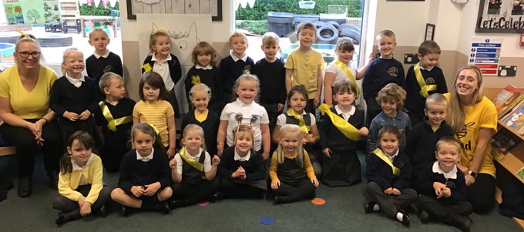
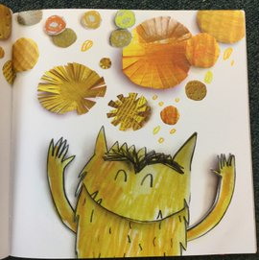
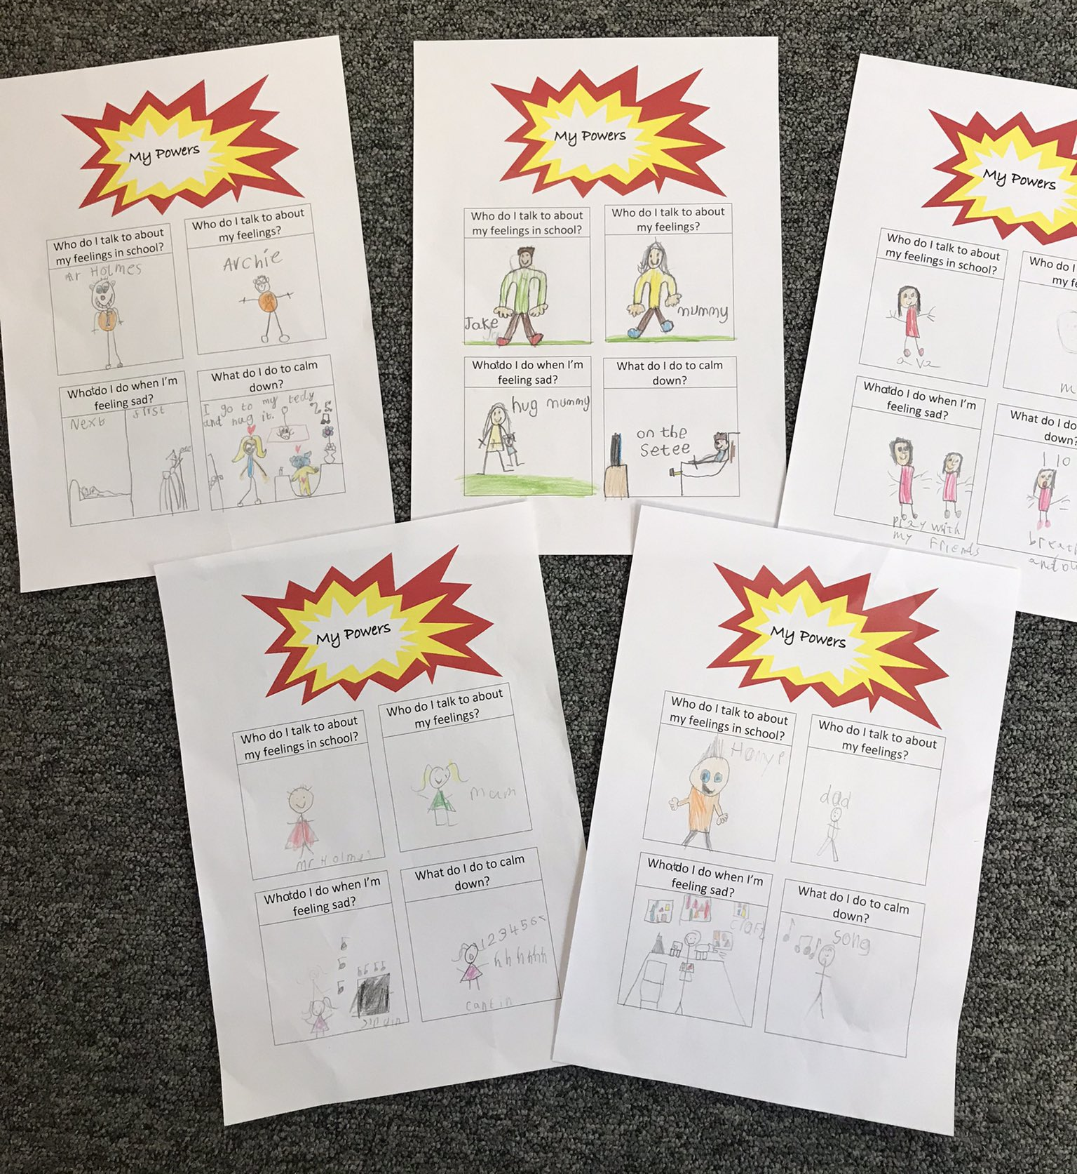

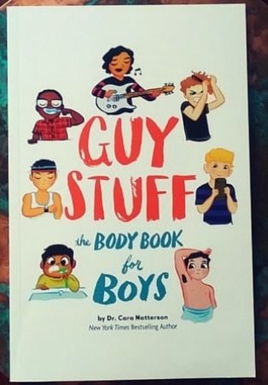

Health
Hygiene
Healthy lifestyle
Puberty- changing body, changing emotions
Notes:
Hygiene
Having a healthy lifestyle incl. exercise, eating healthily but also positive mental health (World Mental Health Day)
Puberty – how this affects their body and their emotions and how to handle this, where they can go to for support, key names for body parts including genitalia
Go into a bit more detail now about Sex Education and what is taught in the ‘Growing Up’ aspect of our PSHE scheme

Slide 15
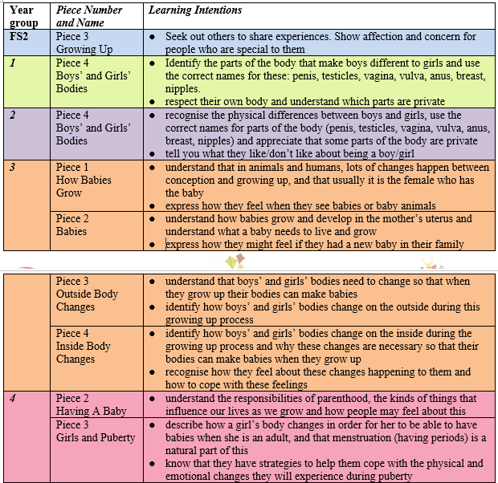
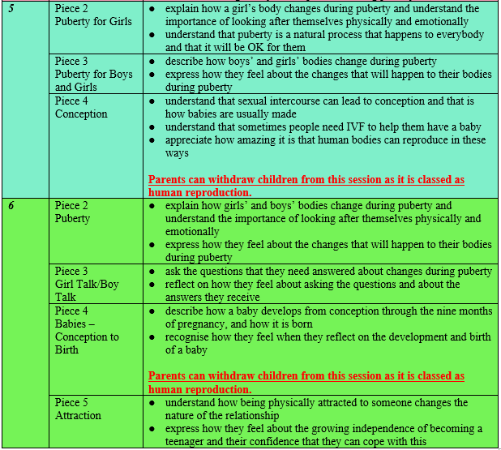
Key Content
Notes:
Key Content in Changing Me where this aspect of education is taught.
It is progressive, building up understanding and knowledge so it isn’t a shock in Y5/6.
KS1- names for genitalia (safeguarding)
KS2 are taught in single age year groups so it is targeted correctly for children.

Slide 16
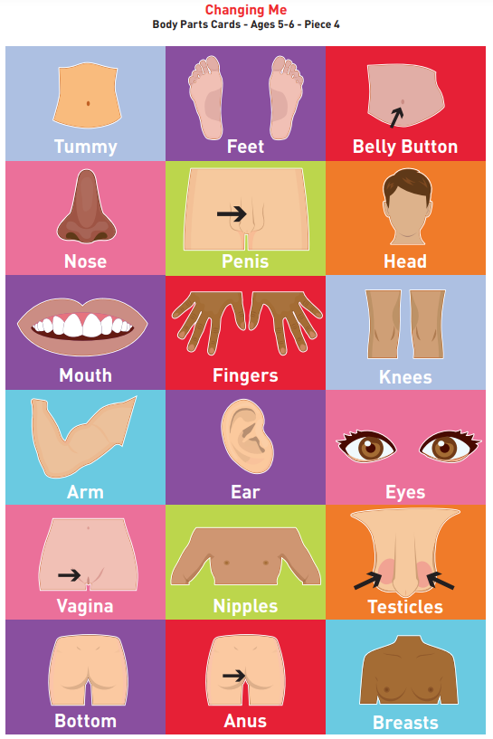
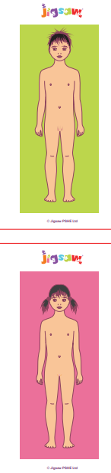
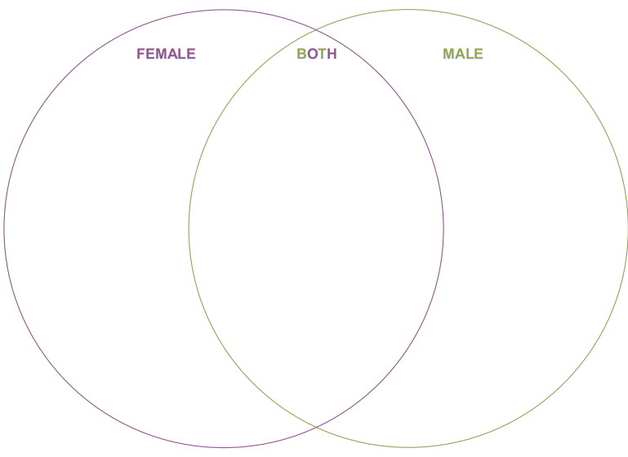
Notes:
Examples- everything is extremely scientific and focused on that

Slide 17
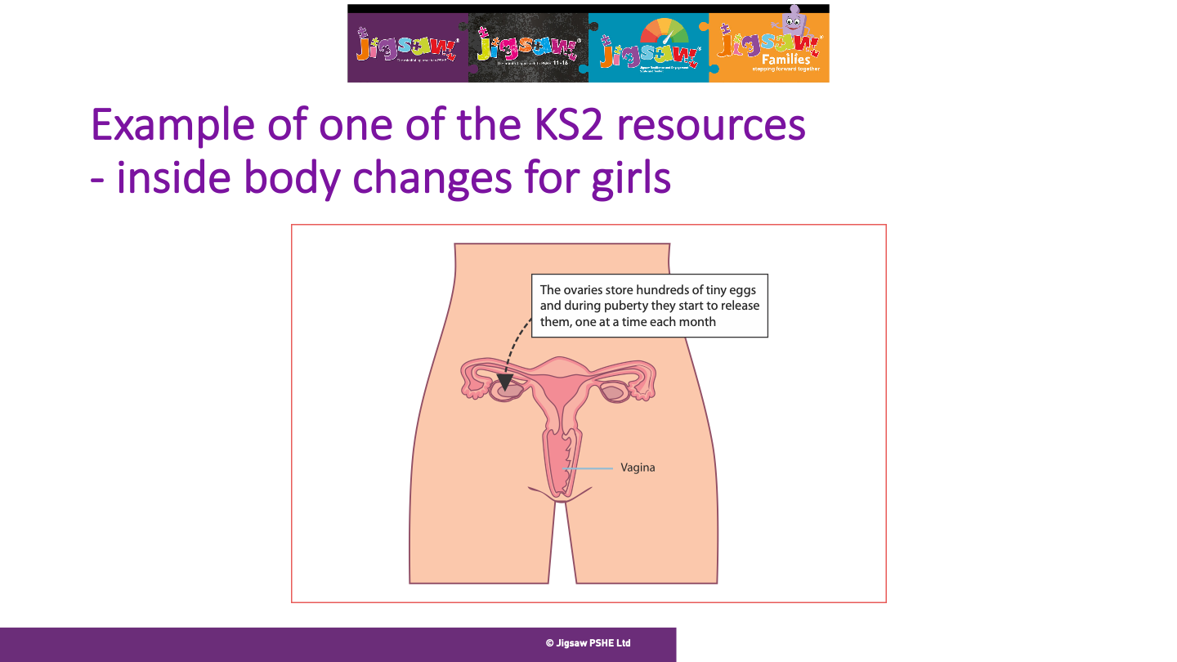
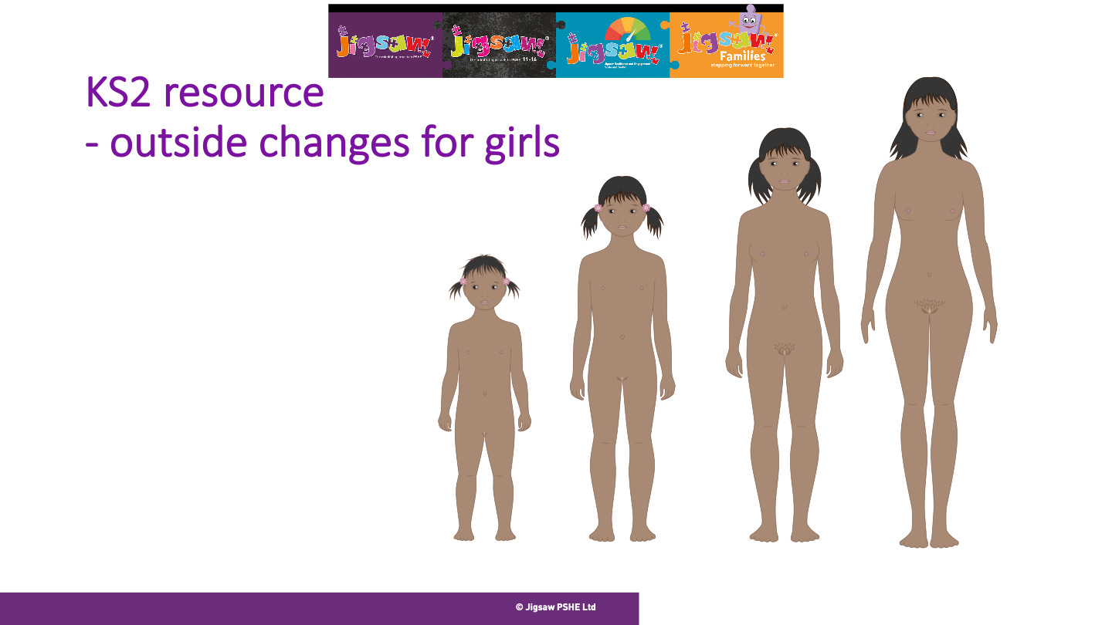
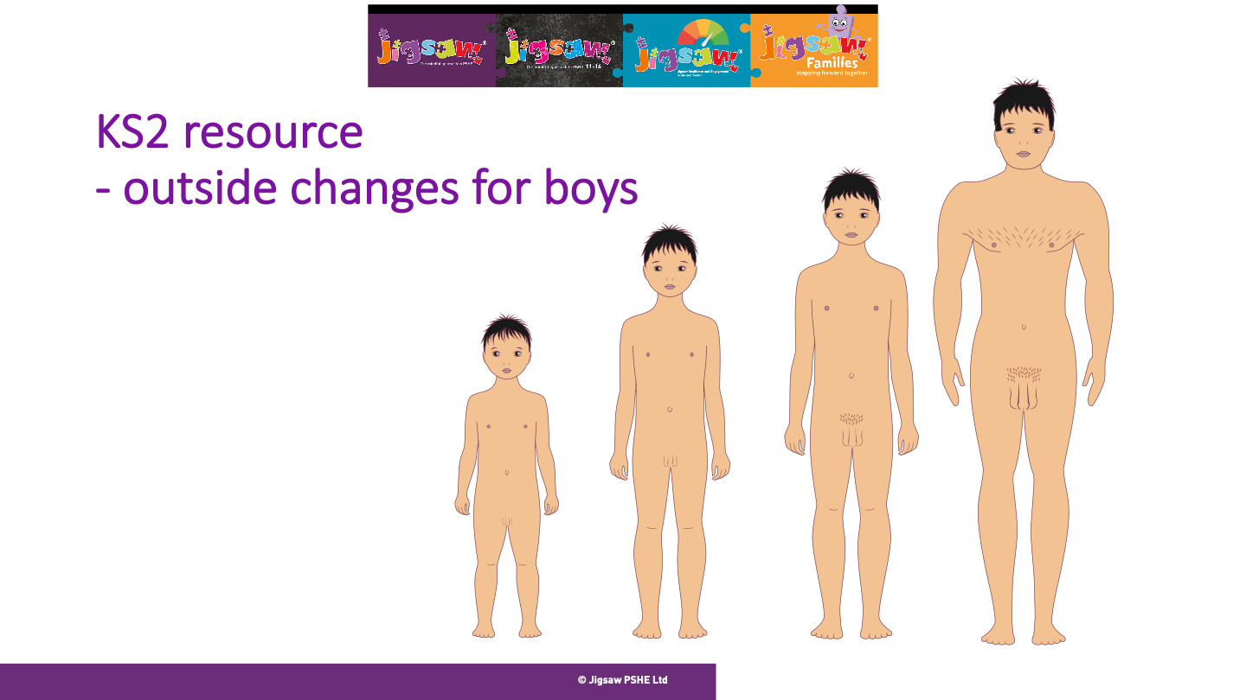
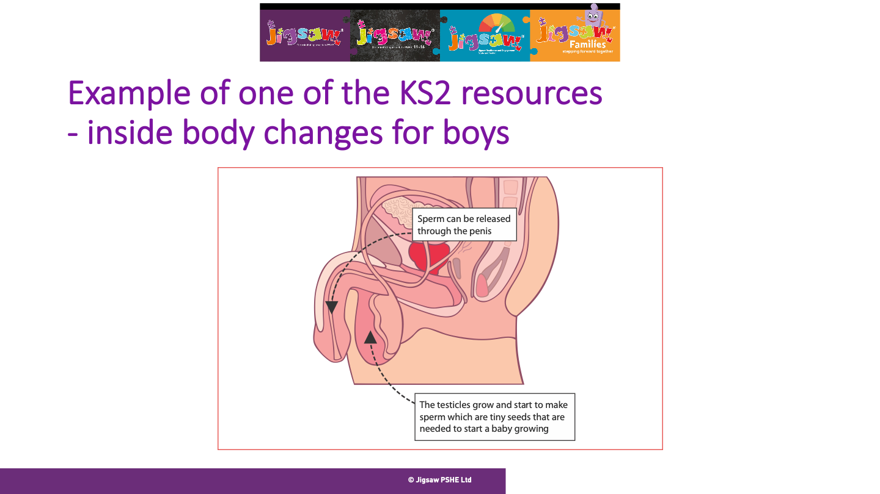
Notes:
Examples- everything is extremely scientific and focused on that

Slide 18
Our lessons create opportunities for…
Dispelling myths
Asking questions including question boxes
Promote safety
Promote respect
Give a safe space for conversations

Slide 19

Talking to your child- handy tips
Reflect on your own experience- did my parents talk to me, did it help?
Answer their simple questions early on
Reply to their questions with small amounts of information first
Sometimes short answers are enough
Use everyday situations to start conversation e.g. soaps..
Use books or leaflets as a prop
Let them know its ok to discuss anything
Notes:
Jane

Slide 20

Thank you
Notes:
Thank you for listening and for your time – really appreciated
Time for questions, hanging about now.
Please complete follow up survey which will be sent out this week.

Slide 22

Music & Lyrics
Heard he in love with some other chick
Yeah, yeah, that hurt me, I'll admit
Forget that boy, I'm over it
I hope she gettin' better sex
Hope she ain't fakin' it like I did, babe
Took four long years to call it quits
Forget that boy, I'm over it
Little Mix- ‘Shout out to my ex’

Slide 23
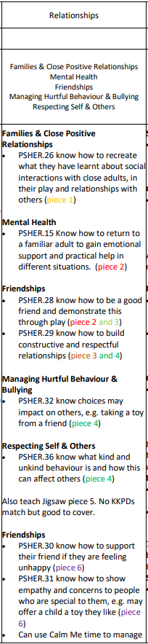
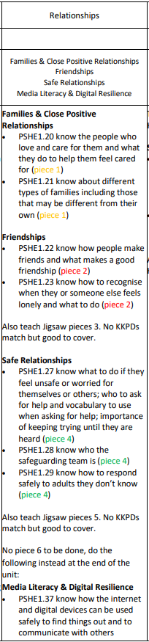
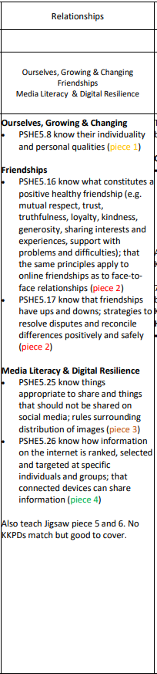
Positive Relationships
EYFS
Reception
Year 1
Year 1
Year 5
Notes:
Four key areas to RSE: Relationships, Safety, Health Education, Age appropriate Sex Education. I will outline the kinds of things we will teach in each one.
Values: Respect, care, kindness, positivity, empathy, ‘love is love’.
Interactions: Being solution focussed, respectful of other opinions and ideas etc., sharing
Different kinds of relationships and families to promote equality and so our teaching and learning reflects society
What is a good relationship? e.g. a friendship, a family relationship, a work based relationship, marriage/civil partnership.

